Slide 1



CAPSTONE PROJECT
Professional Vocational Training Analysis Dashboard
Presented By
Student Name: Ridhi Jain
College Name: SD College of Management Studies (SDCMS)
Department:BBA
Email ID: ridhijain608@gmail.com

Slide 2
OUTLINE:
Problem Statement (Should not include solution)
Proposed System/Solution
System Development Approach (Technology Used)
Algorithm & Deployment
Result (Output Image)
Conclusion
Future Scope
References

Slide 3
Problem Statement:
Data Fragmentation: Managing large-scale vocational training data across multiple Indian districts is difficult due to naming inconsistencies and duplicate district names.
Supply Concerns: Identifying regions with high enrollment but low seating capacity is crucial for maintaining a stable supply of training resources.
Visibility Gap: Without real-time filtering, stakeholders cannot see year-over-year growth trends or sectoral performance clearly.

Slide 4
Proposed Solution:
The proposed system aims to address the challenge of monitoring and analyzing vocational training enrollment across diverse regions to ensure an equitable distribution of educational resources. This involves leveraging data visualization and business intelligence techniques to identify growth patterns and capacity gaps.
The solution consists of the following components:
Data Collection:
Historical Enrollment Data: Gathered data on trainee counts, including year, state, district, and specific training institutes.
Infrastructure Metrics: Utilized data regarding seating capacity and available apprenticeship opportunities to evaluate institutional efficiency.
Data Preprocessing:
Data Cleaning: Handled missing values and standardized naming conventions for districts to ensure accurate geospatial mapping.
Feature Engineering: Created unique identifiers for geographic locations and categorized sectors to allow for multi-layered filtering.
Analytical Framework (Algorithm):
Descriptive Analytics: Implemented aggregation logic to calculate total enrollment velocity and capacity utilization percentages.
Geospatial Analysis: Integrated a dynamic mapping system to visualize regional density and identify underserved vocational hubs.

Slide 5
Deployment:
Interactive Interface: Developed a user-friendly Power BI dashboard with temporal slicers and hitech visuals (Treemaps, Gauges) for real-time data exploration.
Cloud Hosting: Deployed the solution via GitHub, providing the .pbix source file and comprehensive documentation for stakeholder accessibility.
Evaluation:
Performance Metrics: Assessed dashboard effectiveness based on data refresh speed, slicer responsiveness, and visual clarity of "High-Demand" sectors.
UI/UX Optimization: Refined the high-contrast dark-mode theme based on readability requirements for executive-level presentations.
Result: Output Summary
Outcome: Successfully engineered a 360-degree analytical suite that monitors enrollment against seating capacity.
Impact: This solution enables decision-makers to transition from macro-level state trends to micro-level district performance, ensuring that vocational training remains accessible to the public at the right time.

Slide 6
System Approach:
Technology Used: Microsoft Power BI Desktop and Power Query.
Data Preprocessing: Used Power Query to handle missing values and created a Unique_ID to resolve geographic data conflicts.
UI/UX Design: Applied a professional dark-mode theme with high-contrast (white/cyan) text for maximum readability.

Slide 7
Algorithm & Deployment:
Data Input: Utilized Trainees_Enrolled, Seating_Capacity, and Year as primary features.
Visual Logic: Leveraged DAX (Data Analysis Expressions) to calculate sums and percentages for sectoral distribution.
Deployment: The project is deployed via a public GitHub repository containing the .pbix source file and documentation.

Slide 8
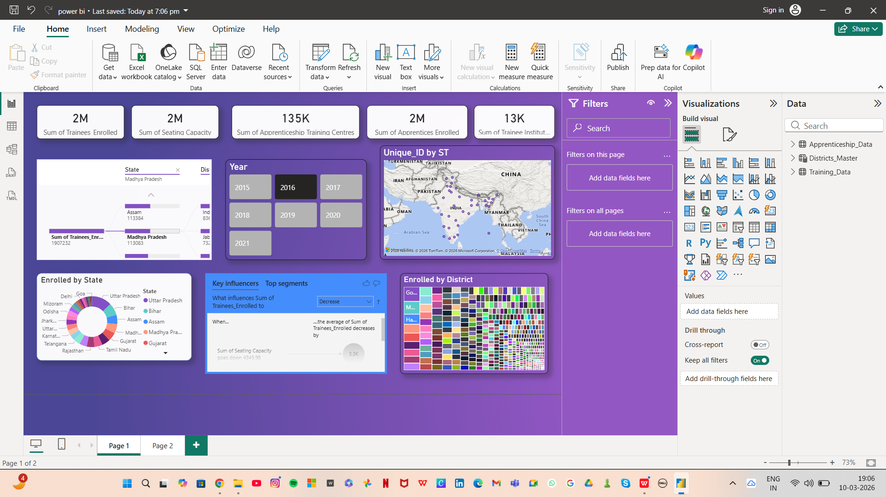
Result:
Key Outcome: Created a 360-degree view of India's vocational landscape, allowing for real-time tracking of institutional efficiency.

Slide 9
Conclusion:
Effectiveness: The dashboard successfully transforms raw Excel data into actionable industrial insights.
Stability: Accurate monitoring of enrollment velocity ensures that training centers remain accessible to the public at the right time.

Slide 10
Future scope:
AI Integration: Incorporating machine learning models to predict future enrollment trends based on historical growth.
Expansion: Extending the system to include real-time placement and salary tracking for students.

Slide 11
References:
GitHub Link: https://github.com/ridhijain709/Microsoft-Elevate-AICTE-Internship-Project.git
NDAP: https://ndap.niti.gov.in/catalogue?sectors=16&search=Variables%2CDatasetInfo&query=*&domain=ndap Skill Development Dashboard Apprenticeship Program Craftsmen Training Scheme

Slide 12
Thank You

